Slide 1

Process Models By Dr. Praveen Kantha

Slide 2
The Waterfall Model
The waterfall model is the basic software development life cycle model.
It is very simple but idealistic.
The classical waterfall model divides the life cycle into a set of phases.
This model considers that one phase can be started after the completion of the previous phase.
That is the output of one phase will be the input to the next phase. Thus the development process can be considered as a sequential flow in the waterfall.

Slide 3
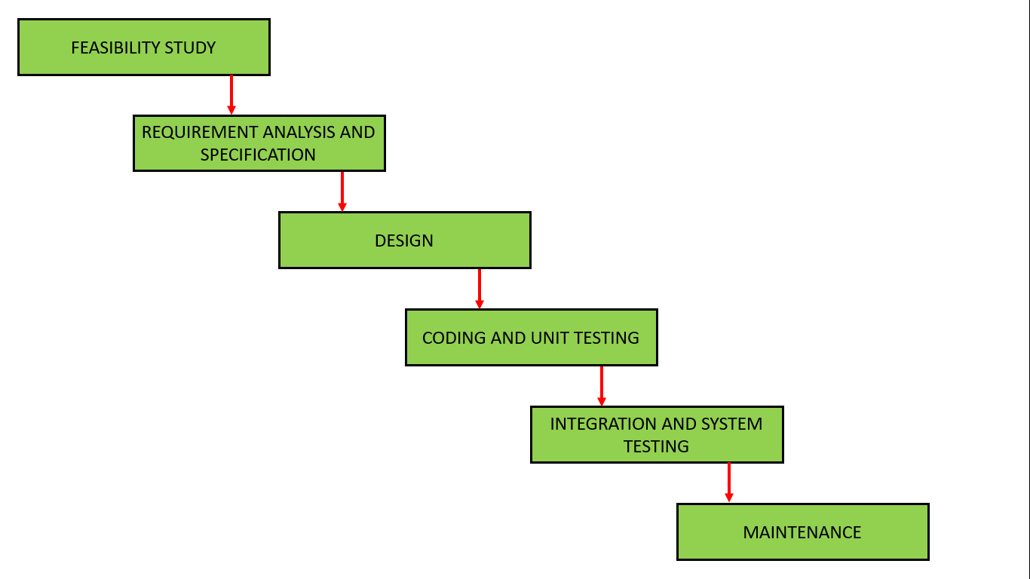
Figure : Waterfall Model

Slide 4
Feasibility Study
The main goal of this phase is to determine whether it would be financially and technically feasible to develop the software.
The feasibility study involves understanding the problem and then determining the various possible strategies to solve the problem.
Types of Feasibility Study :
The feasibility study mainly concentrates on below five mentioned areas.
Technical Feasibility –
In Technical Feasibility current resources both hardware software along with required technology are analyzed/assessed to develop project.

Slide 5
This technical feasibility study gives report whether there exists correct required resources and technologies which will be used for project development.
Feasibility study also analyzes technical skills and capabilities of technical team, existing technology can be used or not, maintenance and up-gradation is easy or not for chosen technology etc.
Operational Feasibility –
In Operational Feasibility degree of providing service to requirements is analyzed along with how much easy product will be to operate and maintenance after deployment.

Slide 6
Economic Feasibility –
In Economic Feasibility study cost and benefit of the project is analyzed.
In this feasibility study a detail analysis is carried out what will be cost of the project for development which includes all required cost for final development like hardware and software resource required, design and development cost and operational cost and so on.
Legal Feasibility –
In Legal Feasibility study project is analyzed in legality point of view.
This includes analyzing barriers of legal implementation of project, data protection acts or social media laws, project certificate, license, copyright etc.
Overall it can be said that Legal Feasibility Study is study to know if proposed project conform legal and ethical requirements.

Slide 7
Schedule Feasibility –
In Schedule Feasibility Study mainly timelines/deadlines is analyzed for proposed project which includes how many times teams will take to complete final project which has a great impact on the organization as purpose of project may fail if it can’t be completed on time.
2. Requirements analysis and specification:
The aim of the requirement analysis and specification phase is to understand the exact requirements of the customer and document them properly.

Slide 8
This phase consists of two different activities.
Requirement gathering and analysis: Firstly all the requirements regarding the software are gathered from the customer and then the gathered requirements are analyzed.
The goal of the analysis part is to remove incompleteness (an incomplete requirement is one in which some parts of the actual requirements have been omitted)
Requirement specification: These analyzed requirements are documented in a software requirement specification (SRS) document. SRS document serves as a contract between the development team and customers.
Any future dispute between the customers and the developers can be settled by examining the SRS document.

Slide 9
Requirement Gathering Techniques
Stakeholders –
The stakeholder means person with interest or concern in outcome of project who is affected by system.
For example- end-user, system maintenance engineer or administrator, software developer, direct user, indirect user, senior manager, etc. By collecting requirements from these stakeholders, understanding system requirements can be very easy.
Interviewing –
Interviewing is important and very effective method of requirement gathering.
Different questions are being asked about system and its uses to stakeholders by team of requirement engineering so that identification of requirements can be done using these answers.

Slide 10
3. System Design
The goal of this phase is to convert the requirements acquired in the SRS into a format that can be coded in a programming language.
It includes high-level and detailed design as well as the overall software architecture.
A Software Design Document is used to document all of this effort (SDD)
4. Coding and Unit testing:
In the coding phase software design is translated into source code using any suitable programming language. Thus each designed module is coded.
The aim of the unit testing phase is to check whether each module is working properly or not.

Slide 11
5. Integration and System testing:
Integration of different modules are undertaken soon after they have been coded and unit tested.
Integration of various modules is carried out incrementally over a number of steps.
During each integration step, previously planned modules are added to the partially integrated system and the resultant system is tested.
Finally, after all the modules have been successfully integrated and tested, the full working system is obtained and system testing is carried out on this.
System testing consists of three different kinds of testing activities as described below :

Slide 12
Alpha testing: Alpha testing is the system testing performed by the development team.
Beta testing: Beta testing is the system testing performed by a friendly set of customers.
Acceptance testing: After the software has been delivered, the customer performed acceptance testing to determine whether to accept the delivered software or reject it.

Slide 13
5. Maintenance:
Maintenance is the most important phase of a software life cycle. The effort spent on maintenance is 60% of the total effort spent to develop a full software. There are basically three types of maintenance :
Corrective Maintenance: This type of maintenance is carried out to correct errors that were not discovered during the product development phase.
Perfective Maintenance: This type of maintenance is carried out to enhance the functionalities of the system based on the customer’s request.
Adaptive Maintenance: Adaptive maintenance is usually required for porting the software to work in a new environment such as working on a new computer platform or with a new operating system.

